Slide 1


Thoughtworks hosts: Federated Machine Learning with Flower: Packaging, Monitoring, Securing
Artiom Troyanovsky & Sara Perricone

Slide 2

Agenda
Workshop setup
Introduction
Federated learning
How it works
Advantages and challenges
Flower
Packaging
Monitoring
Security
Security challenges in FL
Privacy-enhancing techniques
SSL
Closing remarks

Slide 3

Workshop setup

Slide 4

Workshop setup
Clone the GitHub Repo and follow README.md instructions

Slide 5

Introduction

Slide 6

Federated learning
A machine learning technique that allows multiple parties to collaborate and train a model in a decentralised fashion.
Notes:
, also known as collaborative learning,

Slide 7
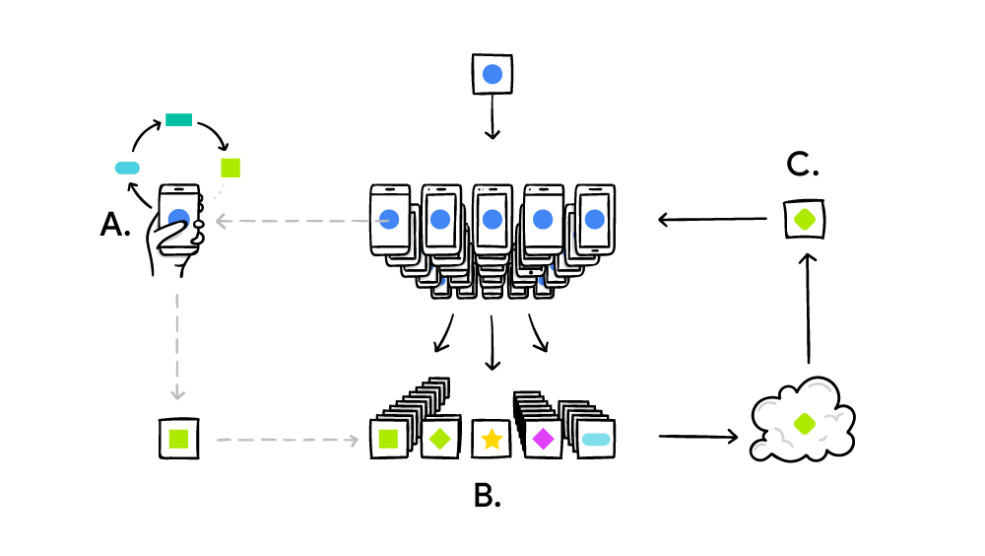
Federated learning - how it works
Image source: https://ai.googleblog.com/2017/04/federated-learning-collaborative.html
Notes:
Federated Learning is a machine learning technique that allows multiple parties to collaborate and train a model while keeping their data private. In federated learning, the training data is stored locally on each device, and the updates to the model are sent to a central server to aggregate them. The central server then sends back the updated model to each device, which continues training locally. This process is repeated until the model reaches a desired level of accuracy.
In a typical federated learning scheme, a central server sends model parameters to a population of nodes (also known as clients or workers). The nodes train the initial model for some number of updates on local data and send the newly trained weights back to the central server, which averages the new model parameters (often with respect to the amount of training performed on each node). In this scenario the data at any one node is never directly seen by the central server or the other nodes, and additional techniques, such as secure aggregation, can further enhance privacy.

Slide 8
Federated learning - how it works
Model training on device
Image source: https://ai.googleblog.com/2017/04/federated-learning-collaborative.html
Notes:
Federated Learning is a machine learning technique that allows multiple parties to collaborate and train a model while keeping their data private. In federated learning, the training data is stored locally on each device, and the updates to the model are sent to a central server to aggregate them. The central server then sends back the updated model to each device, which continues training locally. This process is repeated until the model reaches a desired level of accuracy.
In a typical federated learning scheme, a central server sends model parameters to a population of nodes (also known as clients or workers). The nodes train the initial model for some number of updates on local data and send the newly trained weights back to the central server, which averages the new model parameters (often with respect to the amount of training performed on each node). In this scenario the data at any one node is never directly seen by the central server or the other nodes, and additional techniques, such as secure aggregation, can further enhance privacy.

Slide 9
Federated learning - how it works
Model training on device
Local updates sent to the central server
Image source: https://ai.googleblog.com/2017/04/federated-learning-collaborative.html
Notes:
Federated Learning is a machine learning technique that allows multiple parties to collaborate and train a model while keeping their data private. In federated learning, the training data is stored locally on each device, and the updates to the model are sent to a central server to aggregate them. The central server then sends back the updated model to each device, which continues training locally. This process is repeated until the model reaches a desired level of accuracy.
In a typical federated learning scheme, a central server sends model parameters to a population of nodes (also known as clients or workers). The nodes train the initial model for some number of updates on local data and send the newly trained weights back to the central server, which averages the new model parameters (often with respect to the amount of training performed on each node). In this scenario the data at any one node is never directly seen by the central server or the other nodes, and additional techniques, such as secure aggregation, can further enhance privacy.

Slide 10
Federated learning - how it works
Model training on device
Local updates sent to the central server
Local updates aggregated at the central server
Image source: https://ai.googleblog.com/2017/04/federated-learning-collaborative.html
Notes:
Federated Learning is a machine learning technique that allows multiple parties to collaborate and train a model while keeping their data private. In federated learning, the training data is stored locally on each device, and the updates to the model are sent to a central server to aggregate them. The central server then sends back the updated model to each device, which continues training locally. This process is repeated until the model reaches a desired level of accuracy.
In a typical federated learning scheme, a central server sends model parameters to a population of nodes (also known as clients or workers). The nodes train the initial model for some number of updates on local data and send the newly trained weights back to the central server, which averages the new model parameters (often with respect to the amount of training performed on each node). In this scenario the data at any one node is never directly seen by the central server or the other nodes, and additional techniques, such as secure aggregation, can further enhance privacy.

Slide 11
Federated learning - how it works
Model training on device
Local updates sent to the central server
Local updates aggregated at the central server
Improved parameters broadcasted back to devices
Image source: https://ai.googleblog.com/2017/04/federated-learning-collaborative.html
Notes:
FL 3 components: device, connectivity, aggregation
Difference between edge and federated ML
Edge and federated machine learning (ML) are two approaches to training and deploying machine learning models that differ in how data is processed and where computation takes place.
Edge ML refers to the practice of running machine learning algorithms on devices or sensors at the edge of a network, such as smartphones, IoT devices, or sensors. With edge ML, data is processed locally on the device, and the model is trained and deployed directly on the device. This approach is useful when low latency and real-time processing is required, as data doesn't need to be transmitted to a remote server for processing.
Federated ML, on the other hand, is an approach to machine learning where the data used to train a model is distributed across multiple devices or data centers. Rather than transmitting data to a central server for processing, the models are trained locally on each device, and the updates are aggregated on a central server. Federated ML is useful when the data is sensitive or private, and can't be easily shared with a central server.
One key difference between edge and federated ML is the distribution of computation. With edge ML, computation takes place on the device itself, while with federated ML, computation is distributed across multiple devices or data centers. Additionally, edge ML models tend to be smaller and less complex than federated ML models, as they need to fit within the resource constraints of the device.

Slide 12

Advantages of Federated learning
Privacy
Efficiency
Scalability
Sustainability
Notes:
Privacy: Federated learning allows the training data to remain private on the devices. This ensures that sensitive information is not shared with the central server or other devices
Efficiency: Federated learning reduces the amount of data that needs to be sent to the central server for training. This can help reduce the costs of training and increase the speed of the training process
Scalability: Federated learning can be used to train models on large datasets that are distributed across multiple devices
Sustainability: Federated learning is minimising data storage
Ideally, federated learning aims to preserve individual and institutional privacy while potentially making collaborations between data stakeholders possible where they would normally be impossible due to trade secrecy, private health information, or the increased risk of data breaches.
Paramount among these advantages is the possibility of privacy, yet it is still possible to infer something about the contents of a private dataset from a model parameter update alone.

Slide 13

Challenges of Federated learning
Heterogeneity
Communication
Security
Monitoring
Notes:
Heterogeneity: The devices used for training may have different hardware and software configurations, which can affect the performance of the model
Communication: Federated learning relies on communication between devices and the central server. This can be a challenge when dealing with large datasets or slow internet connections
Security: Federated learning requires a secure communication channel to protect the privacy of the training data
While a typical federated learning scenario might involve a population of mobile phones, for example, all with roughly similar computational capabilities and training the same model architecture, some schemes, such as a HeteroFL by Diao et al. 2021, allow for training a single inference model on a variety of devices with vastly different communication and computation capabilities, even going so far as to train local models with different architectures and numbers of parameters, before aggregating the trained parameters to a global inference model.

Slide 14
Federated learning use cases
Delocalised training of medical AI models at different hospitals, without the need of data sharing
Delocalised training of financial fraud AI models on the data of different financial institutions
Better built-in AI language models that can make use of users’ personal texts, without sharing the data
Delocalised training of a AI model that aims to improve user’s mental welfare

Slide 15

Popular Federated learning libraries
Flower
Tensorflow Federated
PySyft

Slide 16

Federated learning with Flower
Flower:
Exemplifies basic federated learning concepts
Is ML framework agnostic
Easy to install and use
Has built-in federated model algorithms
Runs on python

Slide 17
Federated learning with Flower
Flower clients have the data and train the model locally
Flower server coordinates training/aggregation of model updates.
Federated aggregation algorithms are readily available
Communication between clients and server happens over a secure channel using HTTPS or gRPC
Image source: https://ai.googleblog.com/2017/04/federated-learning-collaborative.html
Notes:
Flower follows a client-server architecture for federated learning, where the clients are the devices that have data, and the server coordinates the training process.
Here's how the client-server structure works in Flower:
Server: The server is responsible for coordinating the training process. It receives updates from the clients, aggregates them, and sends back the updated model to the clients. The server can be hosted on a central machine or in the cloud.
Clients: The clients are devices that participate in the federated learning process. They train the model locally using their data and send the model updates to the server. The clients can be mobile devices, edge devices, or any other devices that have data.
Communication: The server communicates with the clients over a secure channel using HTTPS or gRPC. The clients send their model updates to the server, which aggregates them and sends back the updated model.
Federated Learning Algorithms: Flower provides several federated learning algorithms that can be used to train the model, such as Federated Averaging (FedAvg), Federated Proximal (FedProx), and Federated Learning with Non-IID Data (FedNova). These algorithms are implemented on the server, and the clients only send their model updates to the server.
Device Management: Flower provides a device management system that allows the server to manage the clients that participate in the federated learning process. The server can add or remove clients dynamically and can also distribute the training workload among the clients.

Slide 18

Packaging
Packaging a model before transferring it to an edge device has several advantages:
Reduced model size
Improved model performance
Reduced latency
Notes:
Packaging a model before transferring it to an edge device has several advantages:
1. Reduced model size: Packaging allows for the removal of unnecessary components and dependencies, resulting in a smaller model size that can be easily transferred to the edge device as for instance mobile devices have limited computational capacity.
2. Improved model performance: By optimizing the model for the specific hardware and software environment of the edge device, the model's performance can be significantly improved.
3. Reduced latency: Packaging a model for deployment on an edge device allows for faster inference times and lower latency, as the model can be run locally on the device without requiring data to be sent to a remote server.

Slide 19
Packaging & Deployment
30 minutes

Slide 20

Monitoring

Slide 21

Monitoring of a federated model entails a multi-level strategy
Model performance metrics such as accuracy, precision, recall
Data distribution across clients
Aggregated data metrics, using encrypted data transfer and aggregation at the server level and release of the data
Client-level metrics such as processing time, network bandwidth, and memory usage
Privacy and security
Notes:
Here are some examples of how to monitor privacy and security:
1. Access control: Access control can be used to restrict access to the federated model and data to only authorized users. This can help ensure that the model and data are not accessed or modified by unauthorized users.
2. Threat detection: Threat detection systems can be used to monitor the federated model and data for any suspicious activity or anomalous behavior. This can help identify and mitigate any potential security threats.
3. Privacy audits: Privacy audits can be conducted to ensure that the federated model and data are compliant with privacy regulations and best practices. This can help identify any potential privacy issues and ensure that the model and data are being used in a privacy-preserving manner.

Slide 22
Monitoring federated models
20 minutes

Slide 23

Security

Slide 24

Main security challenges in federated learning
Membership inference attacks
Model poisoning attacks
Model inversion attacks
Security attacks can happen either at the centralized server or at one of the participating devices
Notes:
There is an increasing interest in the FL approach beyond hyperscalers, especially in regulated industries such as healthcare and financial services. However, it’s not widely known that FL by itself doesn’t protect data privacy.
Recent studies demonstrate that FL may not always provide sufficient privacy guarantees, as communicating model updates throughout the training process can nonetheless reveal sensitive information; even incur deep leakage, either to a third-party or to the central server. For instance, as shown by Aono et al. in 2018, even a small portion of original gradients may reveal information about local data.
Three primary attacks can expose sensitive information without ever accessing the local devices’ data:
Membership Inference Attacks:
With Membership inference attacks, adversaries can exploit privacy leakage about individual data records in FL training. The membership inference attack can determine if the record was in the model’s training dataset. An adversary builds a shadow model to create a dataset that is familiar to the original dataset. If the (shadow) model’s prediction has high confidence values, it is similar to the original dataset.
Inference attacks exploit privacy leakage that occurs during gradient sharing in FL training. Model updates can leak extra information about the unintended features of participants’ training data to the adversarial participants, as deep learning models appear to internally recognize many features of the data that are not apparently related to the main tasks.
Model Poisoning Attacks:
Model poisoning attacks affect model performance without being noticed. One could deploy a flipping attack by manipulating the model update or a more complex target attack that can leverage global ML models to do what they want. This blog post details more on model poisoning attacks.
Model Inversion Attacks:
If an adversary can query the model enough times, they can reconstruct the clear-text model using an Equation solving attack. The adversary can learn about the distribution of the training data from other participating devices. The adversary can also save the snapshot of the FL model parameters, and conduct property inference by exploiting the difference between the consecutive snapshots, which is equal to the aggregated updates from all participants less the adversary. The main reason is that the gradients are derived from the participants’ private data.
Vulnerabilities at local devices:
FL produces hyper-personalized model responses from the local updates of individual devices. This makes FL vulnerable to various model inversion and inference attacks on the model parameters.
One of the most common assumptions made in machine learning is that the given data points are independent and identically distributed (IDD) random variables. However, a malicious participant can inject non-IID data to execute poisoning attacks, leading to participants’ local updates varying vastly, thereby affecting global model accuracy.
Local training requires labeled data which are often difficult to produce in most cases. Data science teams are tackling this by designing data pipelines that implicitly capture labels. However, a malicious device can observe the model parameters and updates to infer a significant amount of private personal information such as class representatives, membership, and properties associated with a subset of the training data. Even worse, an attacker can infer labels from the shared gradients and recover the original training samples without requiring any prior knowledge about the training set.
Vulnerabilities at central server:
FL relies on a central server to aggregate the gradient values making it an easier target for malicious attack. Once successfully hacked, adversary actors can deploy a wide range of attacks that can reveal privacy-sensitive information from millions of connected devices.
A malicious or a hacked central server can track the devices and their associated gradient values. Hence by exploiting the confidence could exploit the confidence value revealed along with predictions to reconstruct an edge device’s training data by using a model inversion attack.
A recent study has demonstrated that a compromised central server can reveal sensitive information through reconstruction attacks during gradient client updates and k-nearest neighbor when it explicitly stores the feature value.
Recent work in NeurIPS 2019 showed how a malicious server could completely steal the training data from gradients in just a few iterations using a membership inference attack.
Membership Inference Attacks:
Membership Inference Attacks are a type of privacy attack in which an attacker tries to determine whether a specific data point was used to train a machine learning model. These attacks involve the attacker having some knowledge about the model and access to some input data.
In a membership inference attack, the attacker creates a fake data point and queries the model to determine whether it was used in the training data. The attacker repeats this process for different data points until they can determine with high confidence whether a particular data point was used in the training data or not. This information can be used to infer sensitive information about the individuals represented by the data, and can be used to compromise the privacy of individuals whose data was used to train the model.
Model Poisoning Attacks:
Model Poisoning Attacks are a type of attack in which an attacker intentionally introduces malicious data into the training dataset used to train a machine learning model. The attacker's goal is to manipulate the model's output to achieve a specific outcome.
In a model poisoning attack, the attacker injects poisoned data into the training dataset. This data is carefully crafted to manipulate the model's behavior, often by introducing biases into the model. Once the poisoned data is incorporated into the model, the model's behavior can be manipulated to achieve the attacker's goals, such as classifying specific data points in a particular way or providing false results.
Model Inversion Attacks:
Model Inversion Attacks are a type of privacy attack in which an attacker tries to reconstruct the training data that was used to train a machine learning model by using the model's output.
In a model inversion attack, the attacker feeds a series of input data points into the model and records the output. Using this output, the attacker tries to reconstruct the original training data used to train the model. This information can be used to infer sensitive information about the individuals represented by the data, and can be used to compromise the privacy of individuals whose data was used to train the model.
In summary, Membership Inference Attacks, Model Poisoning Attacks, and Model Inversion Attacks are all types of privacy attacks on machine learning models. These attacks can be used to compromise the privacy of individuals and organizations, and it is important to take measures to defend against them, such as using secure and private machine learning techniques and carefully monitoring the data used to train machine learning models.

Slide 25
Reverse engineering data
y = intercept + slope1 * x1 + slope2 * x2 + slope3 * x3
Solve system of linear equations:
y = intercept + slope1 * x1
y = intercept + slope2 * x2
y = intercept + slope3 * x3
See also deep leakage from gradients

Slide 26

Privacy-enhancing techniques
SSL (Secure Sockets Layer)
Fully Homomorphic Encryption (FHE)
Secure Multi-Party Computation (MPC)
Notes:
SSL (Secure Sockets Layer) is a protocol used to establish a secure encrypted connection between a web server and a web browser. The SSL protocol ensures that the data transmitted between the server and the browser is private and secure.
When a user visits a website that uses SSL, the web browser and the server first establish a secure connection by performing a series of steps called the SSL handshake. During the SSL handshake, the web browser and the server agree on the encryption algorithm and the keys to be used for the session.
Once the SSL handshake is complete and a secure connection has been established, all data exchanged between the web browser and the server is encrypted using the agreed-upon encryption algorithm and keys. This makes it very difficult for third parties to intercept and read the data being transmitted.
SSL is widely used for securing online transactions, such as online shopping and banking, as well as for securing other sensitive information, such as login credentials and personal information. In recent years, SSL has been replaced by TLS (Transport Layer Security), which is an improved version of SSL and provides stronger encryption and better security features.
Fully Homomorphic Encryption (FHE) is a cryptographic technique that allows computations to be performed on encrypted data without the need to decrypt it first. This means that data can be stored and processed securely in the cloud without exposing it to the cloud provider or other third parties. FHE enables the use of advanced privacy-preserving applications, such as machine learning on encrypted data or secure outsourced computation.
Secure Multi-Party Computation (MPC), on the other hand, is a technique that allows multiple parties to jointly compute a function on their private inputs without revealing anything about their inputs to the other parties. This is done by dividing the computation into smaller parts that are executed by the different parties in a collaborative manner. The final result is then computed without any of the parties having access to the other party's input.
MPC can be used to perform secure computations in various settings such as data sharing among different organizations, electronic voting, and many other applications that require computation on sensitive data.
In federated learning, secure aggregation works by encrypting the model updates sent by each device using a technique called homomorphic encryption. Homomorphic encryption allows computations to be performed on encrypted data without the need to decrypt it first. This means that the model updates can be encrypted and sent to the central server without revealing the data used to train the model on the device.
Once the encrypted model updates are received by the central server, they are combined using a technique called secure multi-party computation (MPC). MPC allows multiple parties to jointly compute a function on their private inputs without revealing anything about their inputs to the other parties. In federated learning, MPC is used to combine the model updates sent by the different devices without revealing the individual updates.
After the model updates are combined using secure aggregation, the central server sends the updated model back to the devices for further training. This process is repeated until the model converges to a desired accuracy level.
In summary, secure aggregation in federated learning is a technique used to protect the privacy of individual devices during the model aggregation process. It uses homomorphic encryption to encrypt the model updates sent by each device, and secure multi-party computation (MPC) to combine the encrypted model updates without revealing the individual updates. Secure aggregation enables the benefits of federated learning while protecting the privacy of the data used to train the model on each device.
####
SSL (Secure Sockets Layer) and FHE (Fully Homomorphic Encryption) are two different cryptographic techniques used for different purposes, so there are several differences between them.
SSL is a protocol used for securing communication between a client and a server over the internet. It uses a combination of symmetric and asymmetric encryption techniques to encrypt data transmitted between the client and the server. SSL is widely used for securing web traffic, email, and other internet-based applications.
On the other hand, FHE is a type of encryption that allows computations to be performed on encrypted data without decrypting it first. FHE is useful for protecting the privacy of sensitive data when performing computations on untrusted servers. FHE allows data to be encrypted before it is sent to the server, and computations to be performed on the encrypted data without revealing the data itself. This is useful for scenarios where data is too sensitive to be sent in plaintext over a network.
One of the main differences between SSL and FHE is the type of encryption they use. SSL uses a combination of symmetric and asymmetric encryption techniques to protect data, while FHE uses only asymmetric encryption techniques. Another difference is the purpose they serve: SSL is used for securing communication over the internet, while FHE is used for protecting the privacy of data during computations.
In summary, SSL and FHE are two different cryptographic techniques used for different purposes. SSL is used for securing communication over the internet, while FHE is used for protecting the privacy of data during computations. While both techniques use encryption to protect data, they use different types of encryption and serve different purposes.

Slide 27
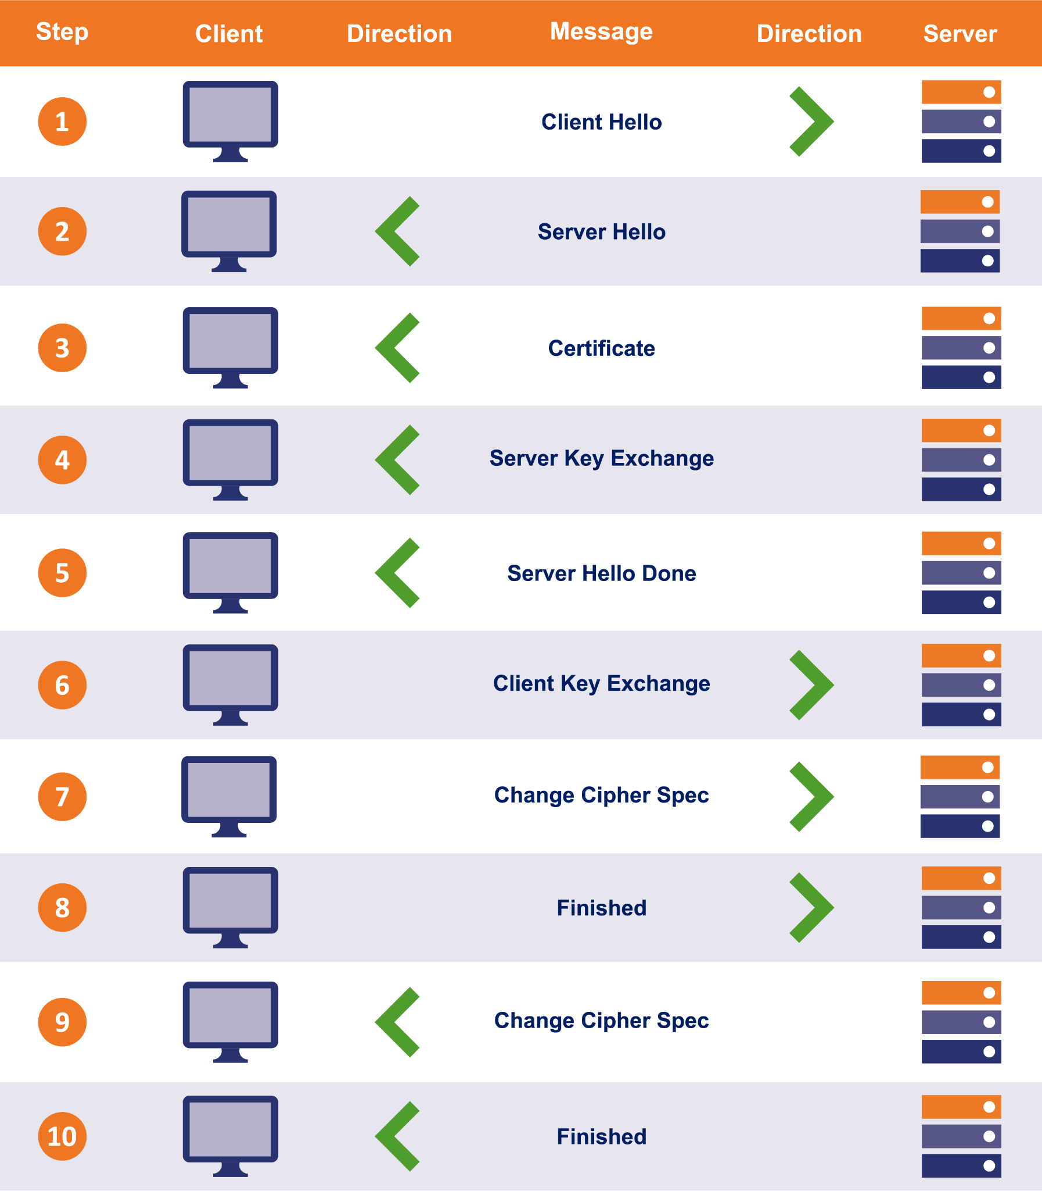
SSL handshake
https://www.thesslstore.com/blog/explaining-ssl-handshake/
Notes:
The client sends a "hello" message to the server, which includes information about the SSL/TLS versions and encryption algorithms that it supports.
The server responds with a "hello" message, including information about the SSL/TLS version and encryption algorithm that it has chosen for the session.
The server sends its SSL/TLS certificate to the client, which contains its public key and other information that allows the client to verify the server's identity.
The client verifies the server's identity by checking the server's SSL/TLS certificate against a trusted list of certificates, and ensures that the certificate is valid and hasn't been tampered with.
The client generates a session key that will be used to encrypt the data transmitted between the client and server during the session, and encrypts it with the server's public key.
The server decrypts the session key using its private key, and confirms that the key is valid.
Both the client and server confirm that they agree on the encryption algorithm and session key, and the SSL/TLS encrypted connection is established.
Once the SSL/TLS connection is established, data can be transmitted securely between the client and server, and the SSL/TLS protocol handles the encryption and decryption of the data at both ends.
###
When a client (such as a web browser) initiates an SSL connection with a server (such as a web server), the following steps typically occur:
The client sends a "hello" message to the server, indicating that it wants to establish an SSL connection. This message includes the SSL version number, supported cipher suites (encryption algorithms), and other details.
The server responds with a "hello" message of its own, including its SSL version number, chosen cipher suite, and other details.
The server sends its digital certificate to the client. The certificate contains the server's public key, as well as other identifying information such as the server's domain name.
The client verifies the server's certificate to ensure that it was issued by a trusted Certificate Authority (CA) and that it hasn't been tampered with or expired. If the client trusts the server's certificate, it generates a random symmetric key (also known as a session key) and encrypts it using the server's public key. The encrypted session key is sent back to the server.
The server receives the encrypted session key from the client and decrypts it using its private key. The server and client now share a symmetric session key that they can use to encrypt and decrypt data during the SSL session.
The SSL connection is established, and the client and server can begin exchanging encrypted data. Data is encrypted using the symmetric session key that was generated during the handshake process.

Slide 28
Security
20 minutes

Slide 29

Closing remarks

Slide 30
Closing remarks
Do you want to know more about data privacy and federated learning?

Slide 31

Our colleague Katherine wrote the book on privacy-first federated learning solutions
“
At its core, federated learning is a way to share models more democratically with users... and it has the added benefit that you can rethink personalization.
”
Katharine Jarmul
Principal Data Scientist, Thoughtworks Germany
Author of Practical Data Privacy (O’Reilly, April 2023)
‹#›

